Slide 1
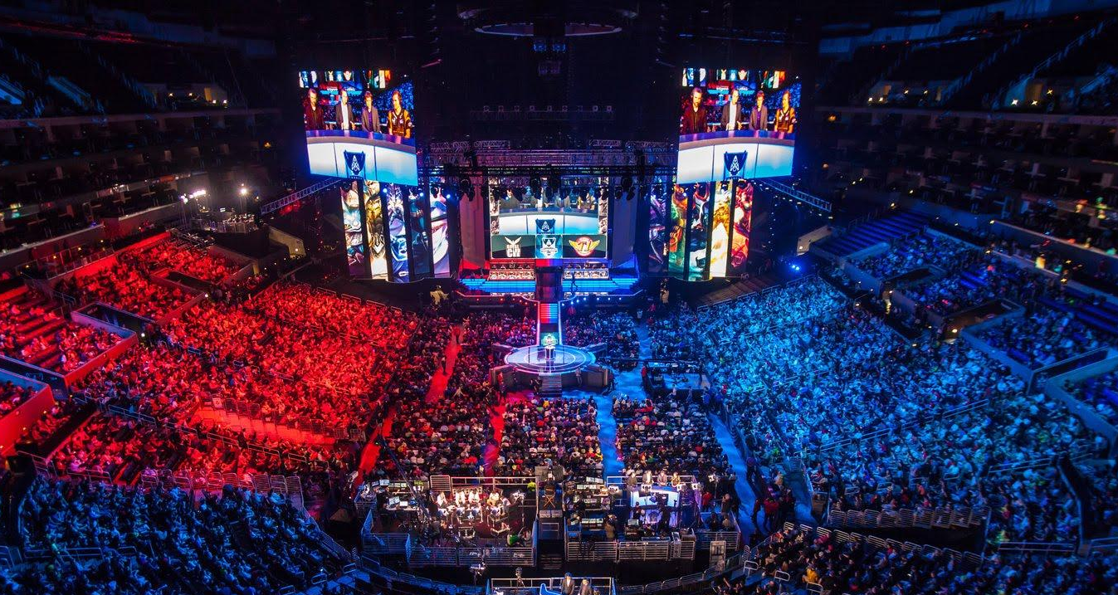
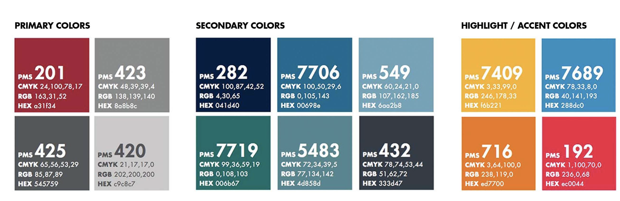

It will come up

Slide 2

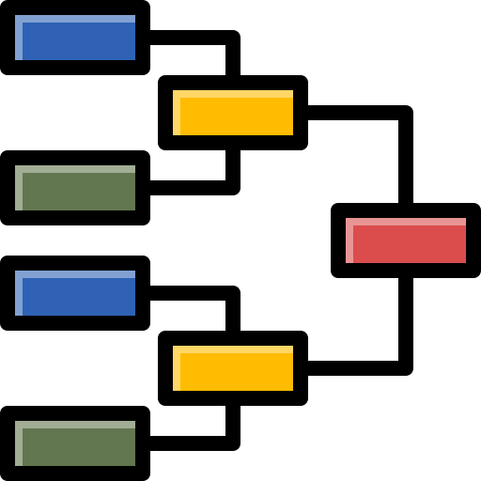
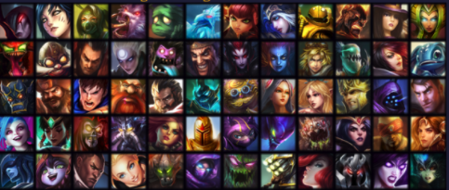
$9.0M Prize pool
LoL
League of Legends is widely considered one of the most popular eSports games
Interest / prize pool increasing….
~4,300 matches
In this project, we want to create models that help
Understand the reasons and factors behind their wins
Help pro-player plans their champion selection
2 sides
5 positions each side
150 champion options

Slide 3
$9.0M Prize pool
Motivation
League of Legends is widely considered one of the most popular eSports games
Interest / prize pool increasing….
~4,300 matches
In this project, we want to create models that help
Understand the reasons and factors behind their wins
Help pro-player plans their champion selection
2 sides
5 positions each side
150 champion options

Slide 4
Data / Feature Engineering
All professional ranked matches 2017-2020.
Matches contained information on 5 players for each team
Match metadata (date, time, league, game update number, etc.)
Data transformation performed for preferred modelling format:
1 match is a single row
Team A vs Team B, features for both teams
Dependent variable: result for Team A (win/loss)
Developed statistics of In-game performance for each player in the past 6 months, year:
Average KDA ratio, Average gold, Player win rate, etc.
Developed statistics of In-game performance for each champion in the past 6 months, year:
Champion win rate, Playrate, etc.
Champion Selection features for each player:
Top lane choice, enemy top lane choice, etc.

Slide 5
Data Splitting
Due to game updates & character strength changes over time, we hypothesized two data splits
Train on 2018-2019, Test on 2020
Predict for future years
Found:
Long imputation times
Needed less random warm starts
Poor AUC prediction performance
New players
New champions
Game update to the meta
Train on 1st half of year, Test on 2nd half
Predict for end of season
Found:
Faster Imputation
Better AUC pred. performance

Slide 6
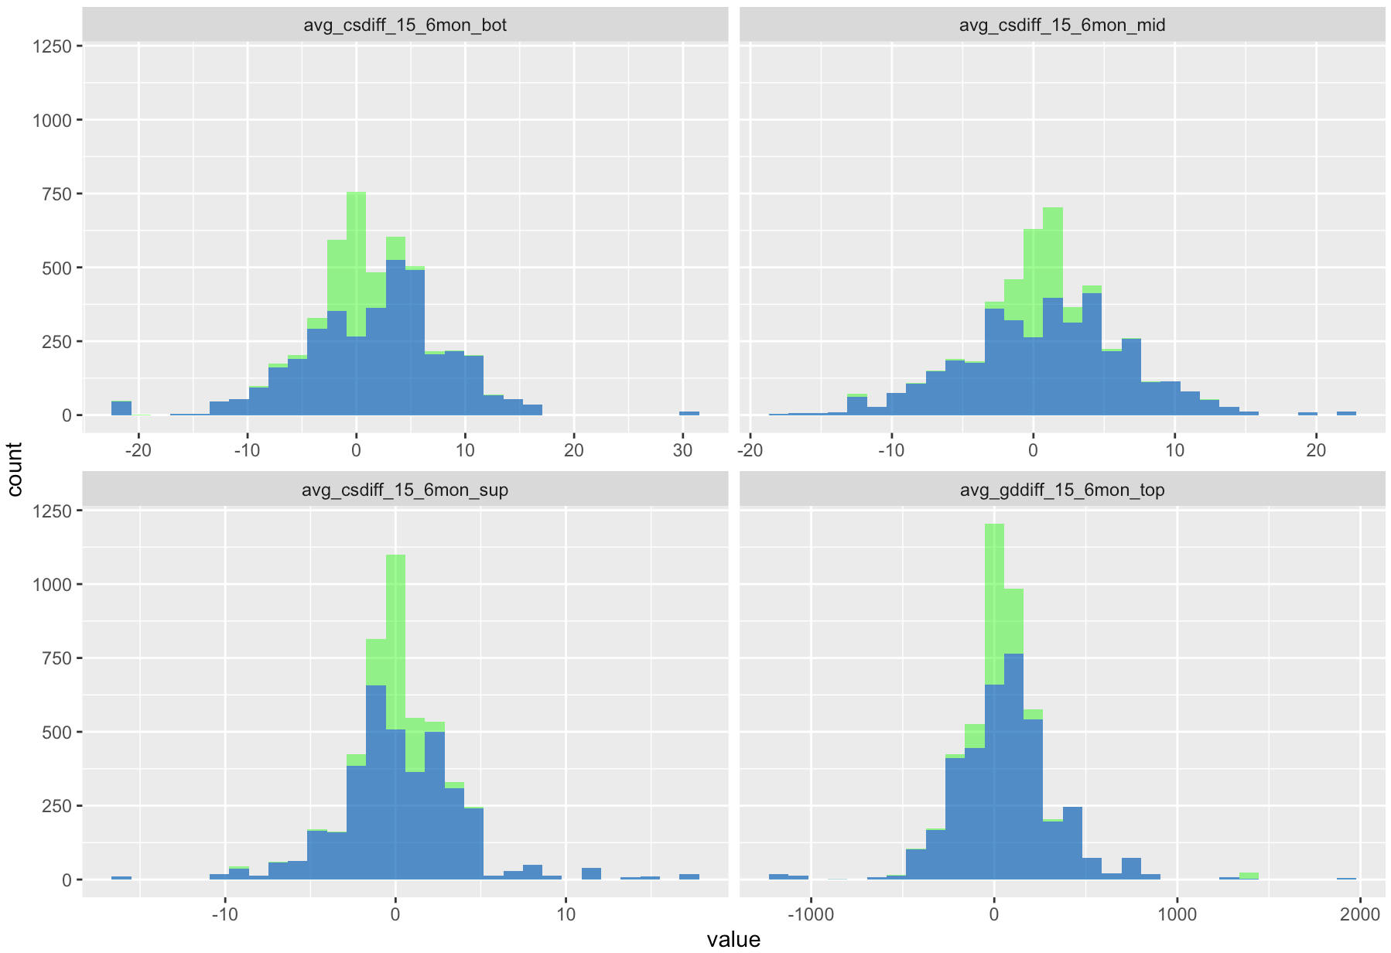
Optimal Imputation
25% missing values with some columns at ~60% missing values
Optimal KNN Imputation was applied
Original Values
Imputed Values

Slide 7
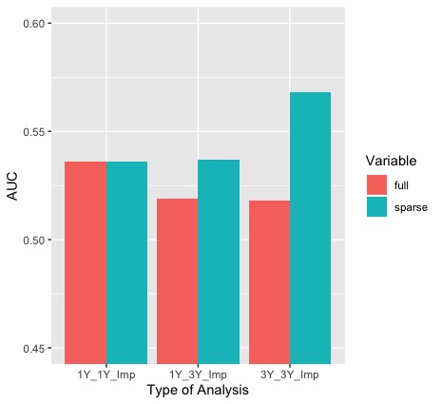
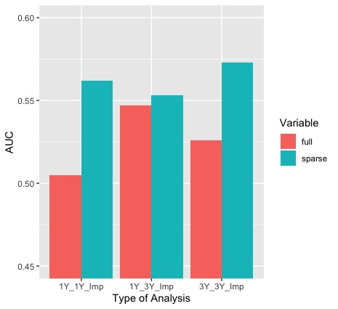
Results – AUC Analysis
CART
OCT

Slide 8
Results – Win/loss Prediction
Full Data
(500 Features):
Sparse Data
(10-16 Features):
 | 3 Years Data (3 Yr imputed) |  | 1 Year Data (3 Yr imputed) |  | 1 Year Data (1 Yr imputed) |  | 3 Years Data (3 Yr imputed) |  | 1 Year Data (3 Yr imputed) |  | 1 Year Data (1 Yr imputed)
 | AUC | Acc. | AUC | Acc. | AUC | Acc. | AUC | Acc. | AUC | Acc. | AUC | Acc.
Logistic/ SVM |  |  |  |  |  |  | 0.594 | 0.573 | 0.603 | 0.588 | 0.602 | 0.572
CART | 0.518 | 0.517 | 0.519 | 0.513 | 0.536 | 0.535 | 0.568 | 0.544 | 0.537 | 0.536 | 0.536 | 0.535
RF | 0.624 | 0.591 | 0.621 | 0.583 | 0.623 | 0.584 | 0.605 | 0.578 | 0.592 | 0.568 | 0.599 | 0.574
OCT | 0.526 | 0.515 | 0.547 | 0.531 | 0.505 | 0.505 | 0.573 | 0.554 | 0.553 | 0.549 | 0.562 | 0.548

Slide 9
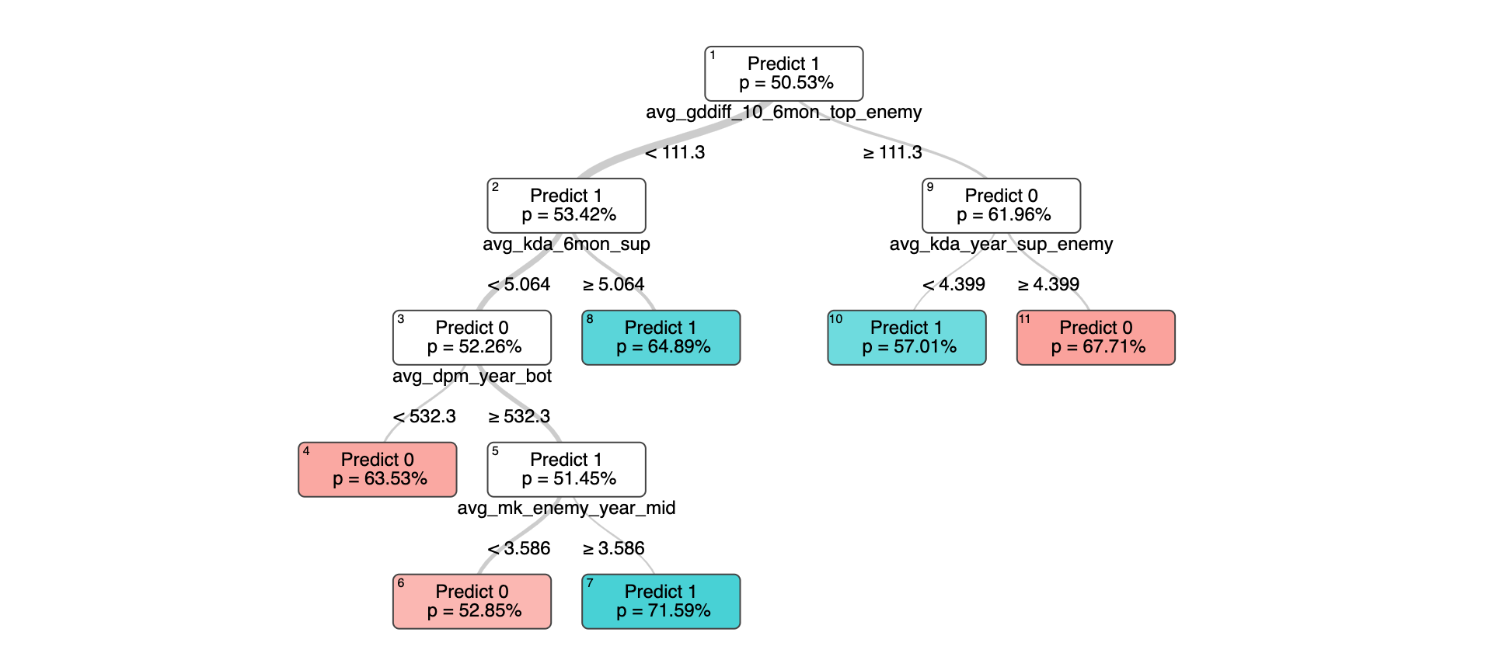
Implications

Slide 10
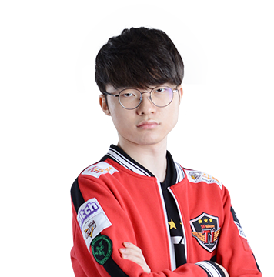





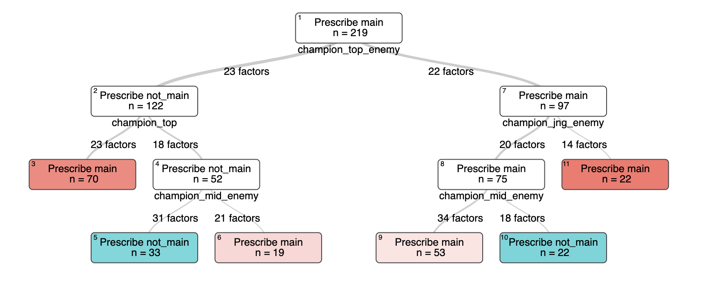

Prescriptive – Strategize Mid-lane’s Champion Selection
Treatment 1: Main Champions
Treatment 2: Other Champions
Decision Factors
Our Top-lane Champion
Enemy Jungle and Mid-lane champion
Results
KDA (Kills + Assists / Deaths)
Original: 7.0
Predicted: 11.9
70%

Slide 11
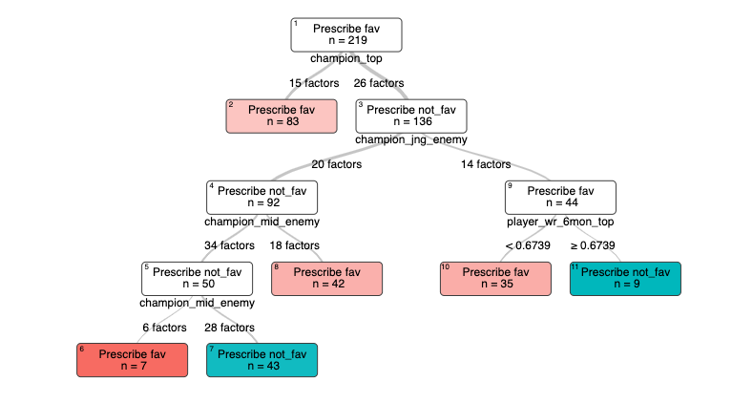
Prescriptive – Strategize Pro-player’s Champion Selection
Treatment 1: Main Champions
Treatment 2: Other Champions
Results
Decision Factors
Our Top-lane winrate
Our Top-lane champion
Enemy’s Jungle champion
Enemy’s Mid-lane champion
Mean Predicted KDA: 0.991
Mean Original KDA: 0.674

Slide 12
Recommendation – Optimal KNN Imputation
 | Features | Observations | Categorical Variables | Estimated Time**
Trial 1 | 525 | 25,000 | 10 (~30 levels each) | Days (unsuccessful)
Trial 2 | 515 | 25,000 | 1 | 1.5 Days
Trial 3 | 260 | 25,000 | 1 | Few hours
Trial 4 | 515 | 4,000 | 1 | 20 minutes
* Every dataset has around 25% missing values
** Using Macbook 2020, RAM 16GB, core i5 processor
Key takeaways: Optimal imputation is a powerful method for a proper data size (Does not scale well especially with data with lots of categorical variables (with multiple levels)

Slide 13
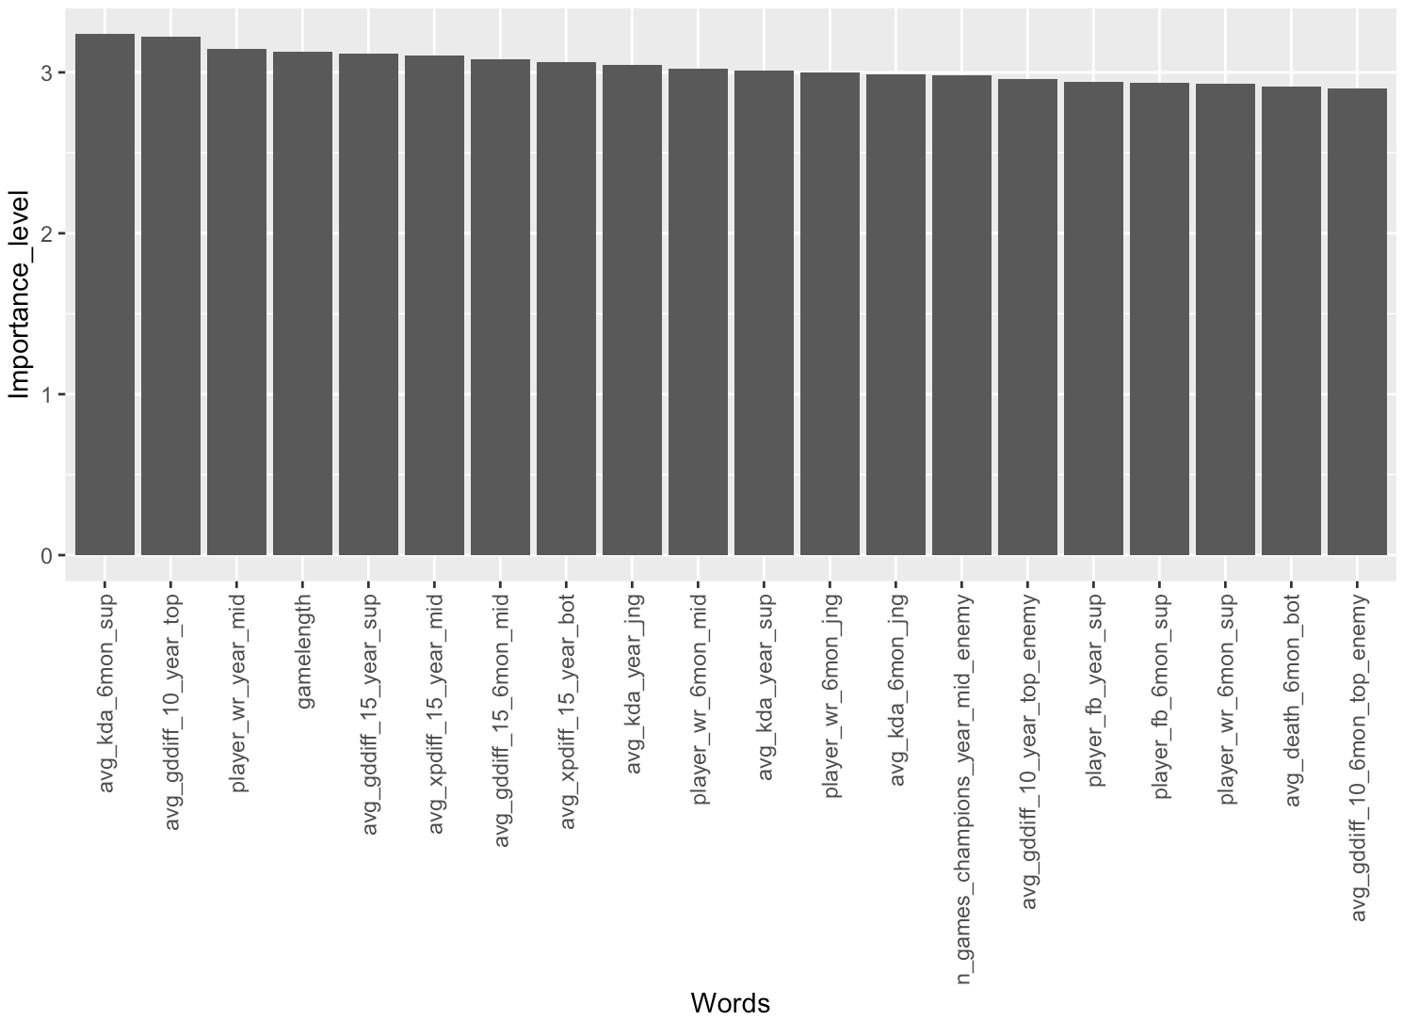
Feature Importance

